Slide 1
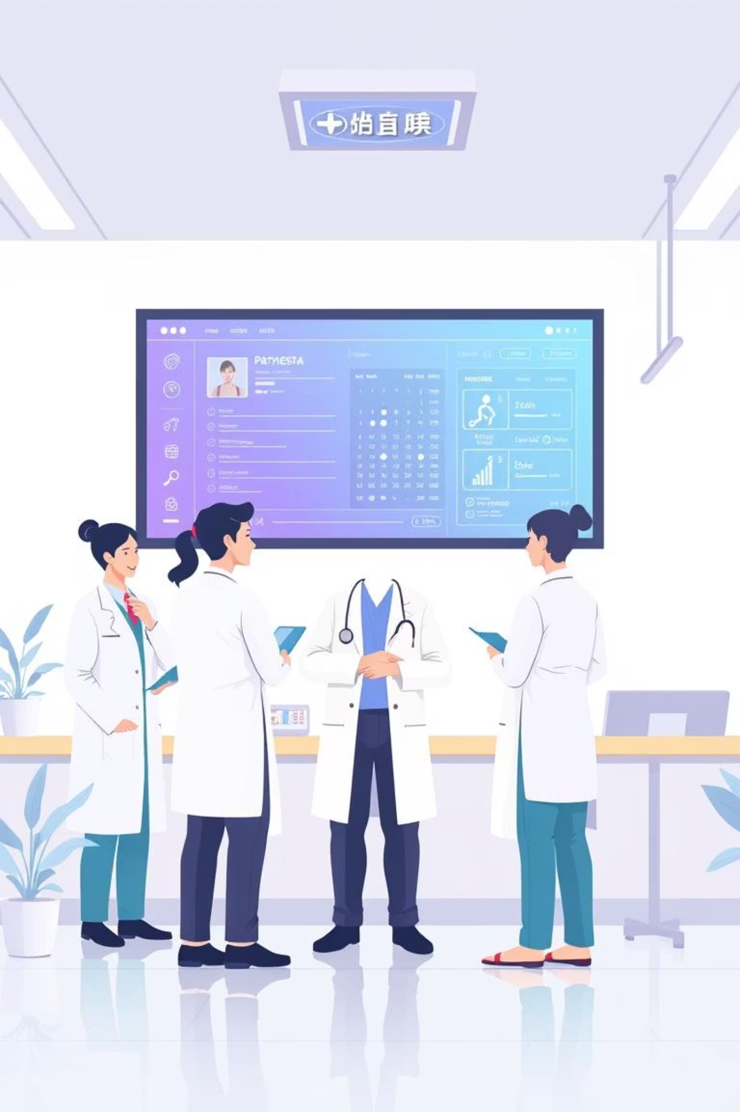
Medical Record System
An Online Medical Center Management System

Slide 2

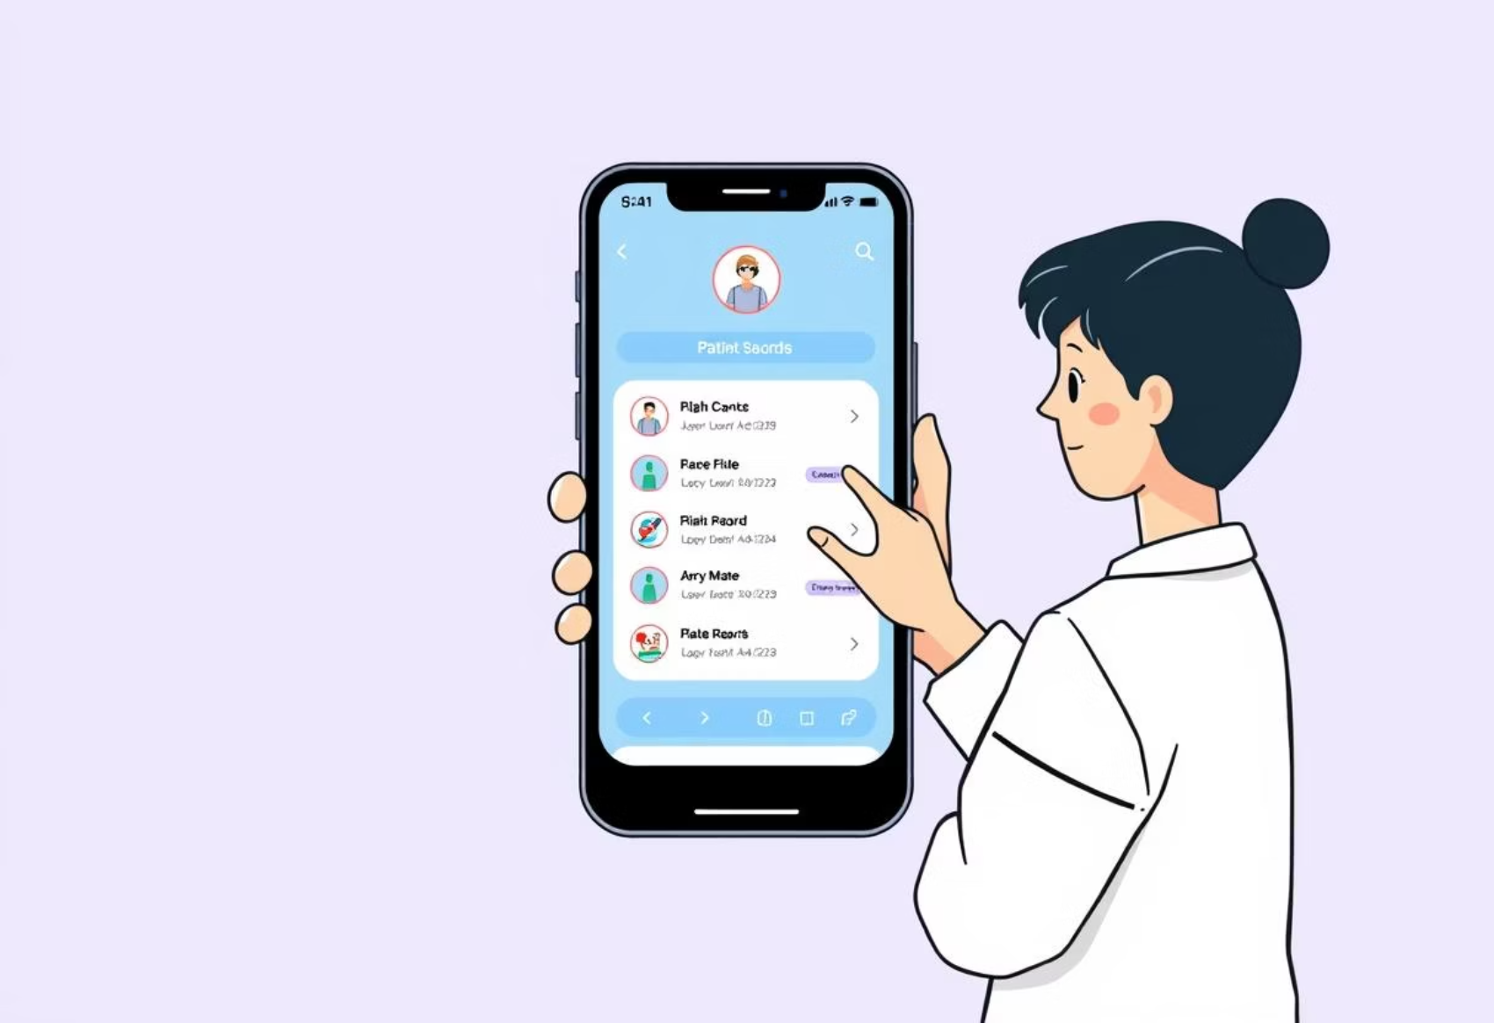
Introduction to the New System
This web-based application replaces the manual, paper-based system at SUST Medical Center, offering a user-friendly graphical interface for all medical management tasks.
Seamless Accessibility
Enhanced User Experience
Accessible via the medical center's intranet for staff and secure internet access for patients.
Intuitive design reduces training time and improves overall efficiency for all users.

Slide 3






Key Project Objectives
Full Computerization
Patient Data Management
To transition the entire medical center management system from manual to digital operations.
Maintain comprehensive records of patient diagnoses, advised tests, and prescriptions.
Medicine Stock Control
Automated Reporting
Effectively manage and track medicine inventory, including procurement and distribution.
Generate various reports for billing purposes and informed medicine procurement decisions.

Slide 4





Diverse System Users
The Medical Record System caters to various user roles, each with specific access and functionalities.
General Users: Patients
Administrative Users: Doctors
Administrative Users: Pharmacists
Includes all students and staff accessing their medical records and appointments.
Responsible for patient diagnoses, prescriptions, and treatment plans.
Manages medicine dispensing and maintains inventory records.
Administrative Users: Store Officers
Administrative Users: Medicine Distributors
Oversees overall medicine stock and supply chain logistics.
Handles inbound and outbound medicine deliveries and stock updates.

Slide 5




Core System Features
The system is designed with a robust set of features to streamline medical center operations.
Patient Management
Comprehensive diagnosis and test record keeping.
Prescription, medication instructions, and diet advice.
Inventory Control
Real-time tracking of medicine stock in all stores.
Monitoring of newly purchased medicine and distribution.
Automated Reporting
Billing reports for employee patients.
Automated medicine procurement suggestions.
Enhanced Security
Secure password retrieval via hint questions.
Role-based access control for data integrity.

Slide 6

Underlying Technologies
The Medical Record System leverages modern technologies for optimal performance and scalability.
Client-Side
Server-Side
Web Browser Compatibility
Web Server: Apache Tomcat for robust web serving.
Any Operating System Support
Database: MySQL for reliable data storage and retrieval.
Programming Languages
HTML for Structure
CSS for Styling
JavaScript for Interactivity
PHP for Server Scripting
Java for Backend Logic

Slide 7
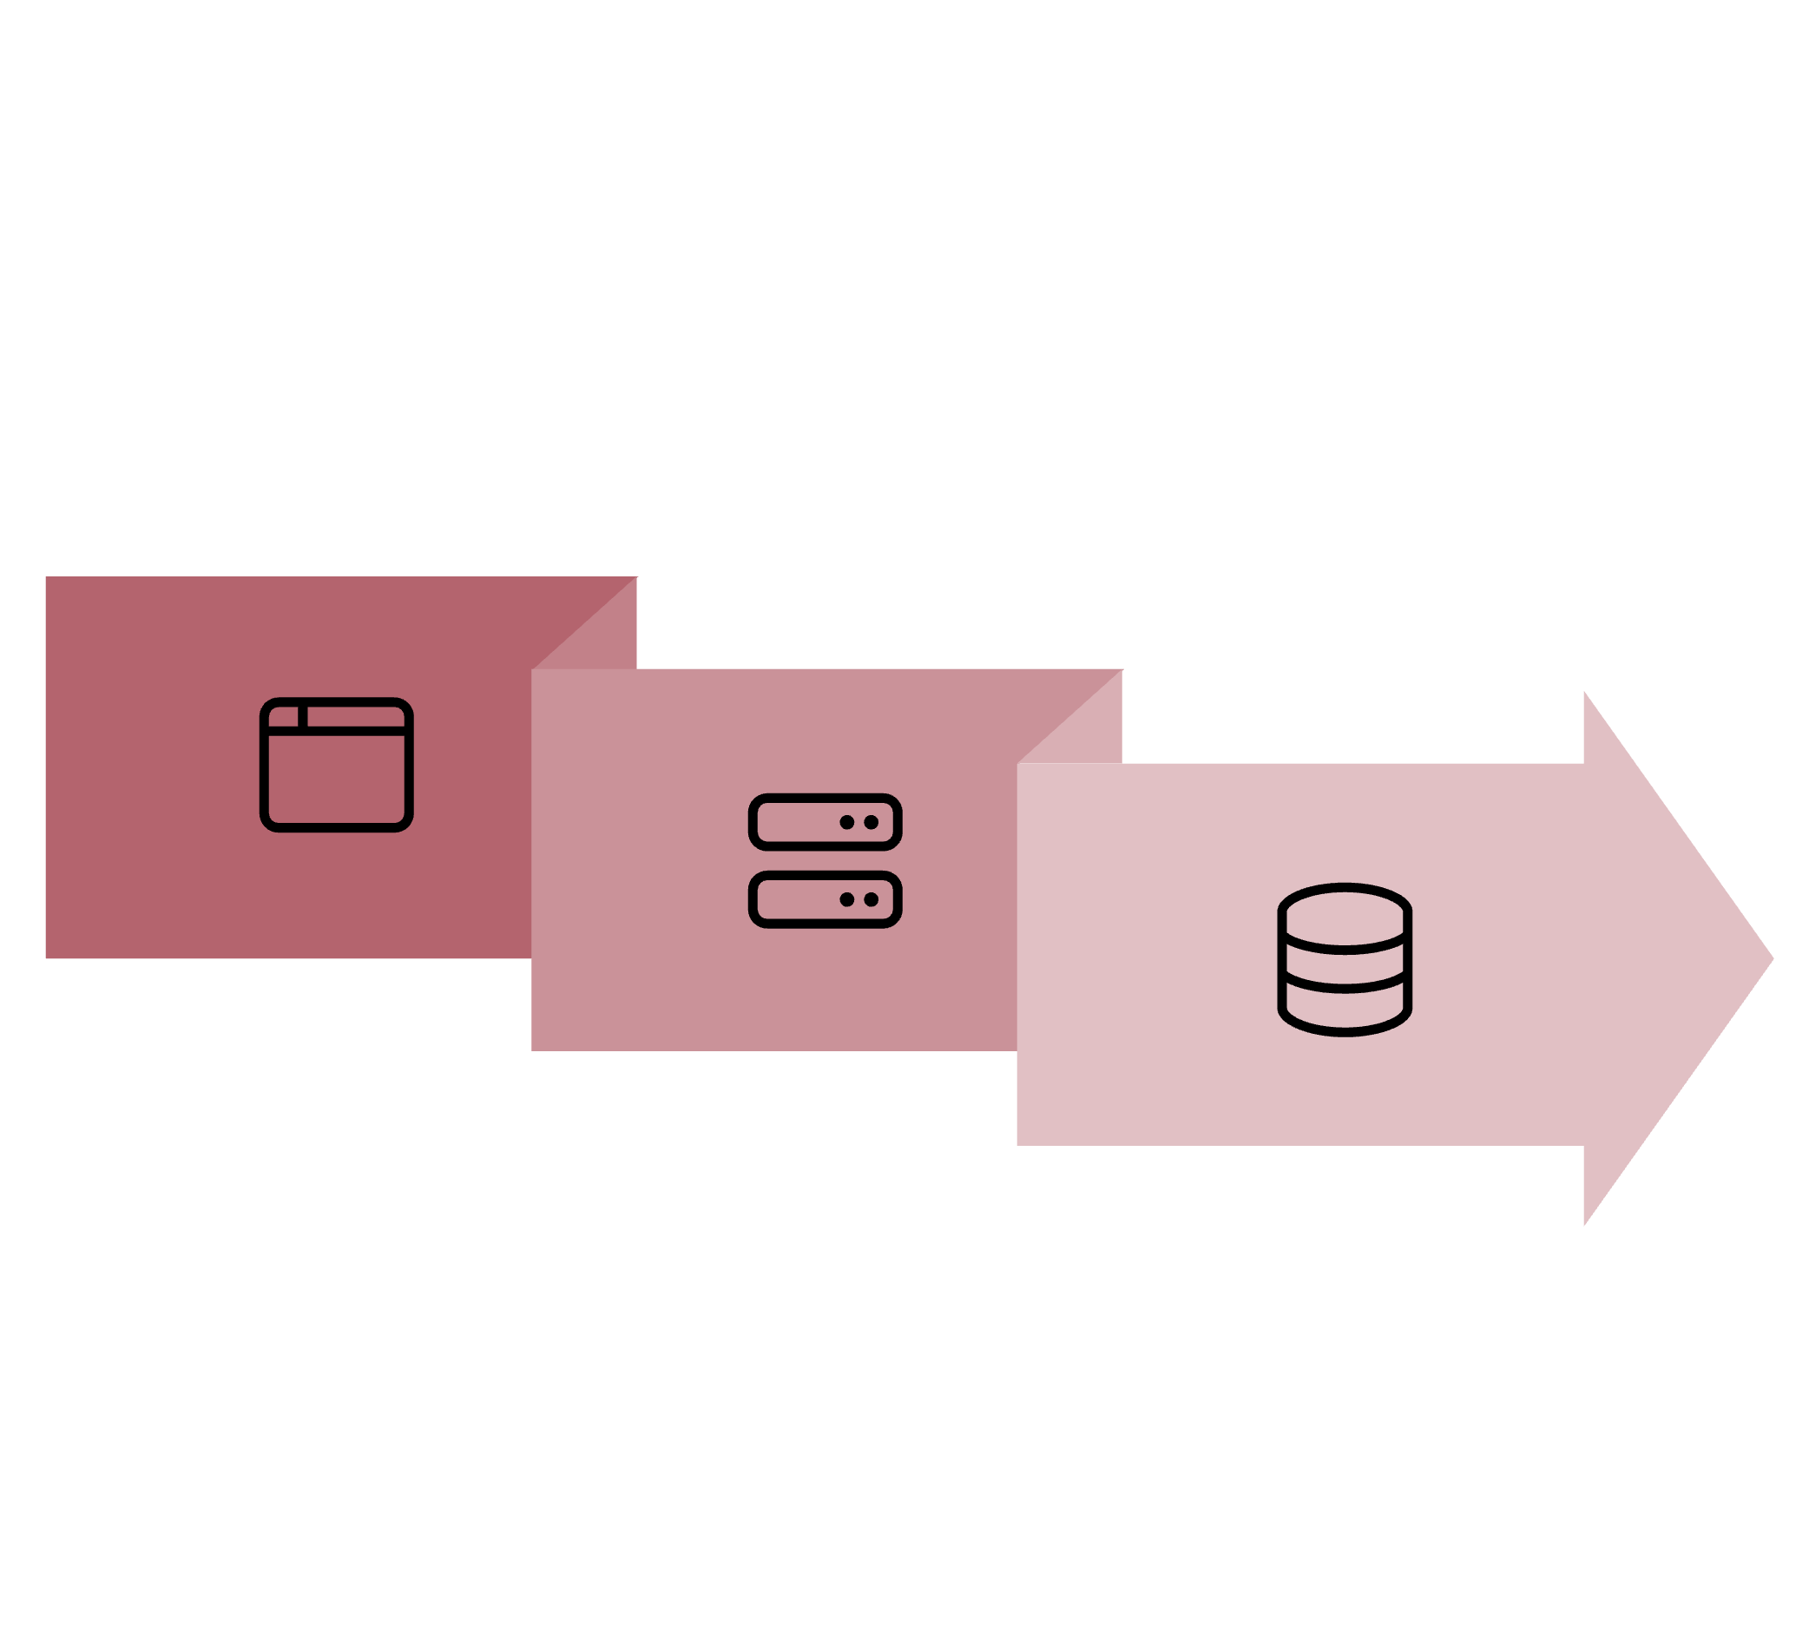



System Architecture Overview
The system employs a standard client-server architecture to ensure efficient data flow and accessibility.
Web Browser
MySQL Database
Apache Tomcat
This layered approach ensures scalability, security, and maintainability, allowing seamless interactions between all components.

Slide 8



Conclusion and Future Outlook
The Medical Record System is a comprehensive solution poised to modernize medical center management at SUST.
30%
25%
45%
Efficiency Boost
Enhanced Access
Future Growth
Reduces paperwork and administrative overhead, improving operational speed.
Provides better and faster access to critical information for staff and patients alike.
Potential for mobile app integration and advanced data analytics to further enhance capabilities.

